Slide 1

2015 Budget Review and Facility Update
January 25, 2015

Slide 2
2015 Ministry Budget
Year-end 2014 Bank Balance: $290,000
Notes:
This first page shows the budget for Christ the King for 2015.
$240k budget is an increase of $30k over last year’s budget
Two-thirds of the budget covers Patrick salary, including taxes, insurance and housing allowance, along with two part-time staff: Paul McAndrew for worship coordination and Imelda Ottmers for administration
Worship and Facility makes up 15% or $36k; just over half this amount ($19.2k) is rent paid to FBC; in addition, we pay liability insurance and maintenance costs
Missions and Support includes amounts paid to our denomination (the PCA), our Presbytery and the SWCPN. We also give support to missionaries some who are members residing here in the Duncanville area and two other overseas… Kyria Johnson in West Africa and Brett and Taylor Rahl in Japan.
Then you will see that we have small amounts budgeted for Christian Education and Events and for Administration.
CE &E includes: Adult and youth education, nursery and child care ($4.1k) and web site, socials, refreshments ($5.3k)
Administration: office supplies, printing, legal & CPA, software, etc.
Lastly, we ended 2014 with about $290k in the bank. Through your generous giving and prudent financial management, we have been able to save each of the last three years for a potential facility requirement in the future. Total giving in 2014 exceeded expenditures by $65k, and the elders allocated this to the Ministry Growth fund, which can be used for a facility.

Slide 3
Attendance Trend
Jan ‘15
Notes:
This slide gives a picture of the trend in attendance at CtK during 2014.
For the most part, the first half of the year trended around 85 people. (J 98, F 85, M 85, A 87, M 86, J 77). During the summer our numbers began rising, and the second half of the year average around 100 people. (J 88, A 104, S 108, O 101, N 104, D 97). Highest attendance was 117 on September 7th.
We also saw a couple of families move away from the area during the year (DeBoers, Gilchrists).
So far in January 2015 we have averaged 116.

Slide 4
FBC Facility Rental
Shared-use of FBC facility since September 2013
  Sanctuary: Sundays 8:00 – 10:45
  Nursery: Sundays 8:00 – 12:30
  Fellowship Hall, Kitchen, Youth Room: Sundays 10:45 – 12:00
  Classrooms: Sundays 10:45 – 12:30
  Other use during the week by request
On-site locked storage for audio equipment, nursery supplies, kitchen supplies, etc.
CtK provides janitorial services twice per month
Further CtK growth will strain facility capacities
Notes:
I want to talk a little bit about our current facility. We entered a rental agreement with FBC in September 2013. It is renewable every six months and can be cancelled by either party. We share space with FBC on Sunday mornings and have access to certain rooms in the building during specific hours shown on this slide. If we want additional time and space, we can request it from FBC and if it is available there is no extra charge.
We have locked storage for supplies and equipment. We also provide janitorial services twice per month. We are thankful for the situation here at FBC, and I think it has been a mutual benefit to the two churches.
However, I want to give some figures to illustrate the capacity limits of the facility:
The most obvious is the nursery: the last three Sundays have seen 10, 12 and 10 children in nursery plus nursery workers. If you want to see a crowded nursery, stick your head in some Sunday morning
The sanctuary can seat approximately 180 people. Most church planners advise that a room feels full and begins to turn people away when it reaches 80% of capacity. That would be about 150 in this building. So we could grow some but not a lot before we reach this level.
The fellowship hall had about 50 people on January 18th and was very full. In order to accommodate more we would need to reconfigure seating to more of a classroom style.
Lastly, parking has capacity for 60 cars. 2.5 per car equals about 150 people.

Slide 5
CtK Facility Search
Planning a comprehensive facility search using an outside real estate agent (beginning February 2015)
Developed facility requirements document to aid search
  Some key considerations:
    Proximity to major traffic arteries
    Room for growth in worship attendance and programs
    Appropriate space for infants and children
    Safe / secure access throughout the week
Willing to consider lease or purchase
  Purchase would require a capital-raising campaign
Focus on total cost to operate
  Including any fix-up costs and on-going cost of operations
Notes:
Before FBC became available, a team searched extensively for suitable facilities in the Duncanville vicinity and found very little available. Over the past year the elders have visited several properties but typically found owners who had not decided about selling or properties that were not appropriate. Late last summer we met with agents from Henry S. Miller realtors who have experience in South Dallas County. They walked us through the process for conducting a thorough search for a new facility.
At the time we concluded we were not quite ready to take on the task of working with a realtor to evaluate properties. So we took some time to evaluate the needs of the church and various trade-offs we may need to make in the search. This developed into a facility requirements document which will aid us in our search.
Listed here are some of the key considerations in this document:
Proximity to major traffic arteries: not deep within a sub-division where it cannot be accessed from freeways;
focus of search zone will be a rectangle with I-20 and Hwy 67 as the center; you can draw the rectangle around this intersection, say about 5 miles north or south and bounded by I-35 on the east and Spur 408 west
Room for growth: this includes adequate sanctuary space… for 250 +/- people, as well as room for adult Sunday schools, fellowship areas, etc.
Space for infants and children is a priority: composition of this space is flexible, but must be adequate for young families with children
Our people should feel safe and secure coming and leaving the facility at any time during the week; this means good lighting, appropriate access and a suitable neighborhood

Slide 6
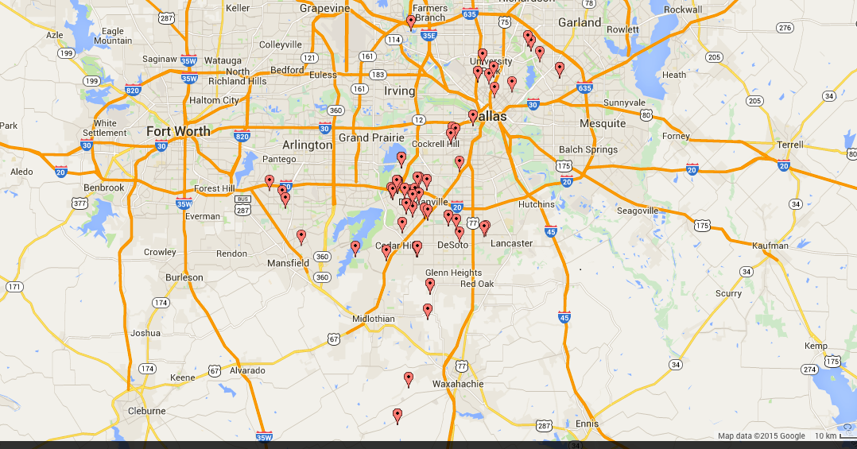
CtK Facility Search

Slide 7
CtK Facility Search
Planning a comprehensive facility search using an outside real estate agent (beginning February 2015)
Developed facility requirements document to aid search
  Some key considerations:
    Proximity to major traffic arteries
    Room for growth in worship attendance and programs
    Appropriate space for infants and children
    Safe / secure access throughout the week
Willing to consider lease or purchase
  Purchase would require a capital-raising campaign
Focus on total cost to operate
  Including any fix-up costs and on-going cost of operations
Notes:
Before FBC became available, a team searched extensively for suitable facilities in the Duncanville vicinity and found very little available. Over the past year the elders have visited several properties but typically found owners who had not decided about selling or properties that were not appropriate. Late last summer we met with agents from Henry S. Miller realtors who have experience in South Dallas County. They walked us through the process for conducting a thorough search for a new facility.
At the time we concluded we were not quite ready to take on the task of working with a realtor to evaluate properties. So we took some time to evaluate the needs of the church and various trade-offs we may need to make in the search. This developed into a facility requirements document which will aid us in our search.
Listed here are some of the key considerations in this document:
Proximity to major traffic arteries: not deep within a sub-division where it cannot be accessed from freeways;
focus of search zone will be a rectangle with I-20 and Hwy 67 as the center; you can draw the rectangle around this intersection, say about 5 miles north or south and bounded by I-35 on the east and Spur 408 west
Room for growth: this includes adequate sanctuary space… for 250 +/- people, as well as room for adult Sunday schools, fellowship areas, etc.
Space for infants and children is a priority: composition of this space is flexible, but must be adequate for young families with children
Our people should feel safe and secure coming and leaving the facility at any time during the week; this means good lighting, appropriate access and a suitable neighborhood

Slide 8
CtK Facility Search
Planning a comprehensive facility search using an outside real estate agent (beginning February 2015)
Developed facility requirements document to aid search
  Some key considerations:
    Proximity to major traffic arteries
    Room for growth in worship attendance and programs
    Appropriate space for infants and children
    Safe / secure access throughout the week
Willing to consider lease or purchase
  Purchase would require a capital-raising campaign
Focus on total cost to operate
  Including any fix-up costs and on-going cost of operations
Notes:
We listed out a number of other attributes which I would characterize as “wish list” for an ideal property. We expect there will be trade offs with any facility, so it is not necessary that we achieve everything listed in the requirements document. However, we believe this will help us narrow the search.
A leased facility or possibly a purchase would be a consideration. We don’t believe we can embark on building a facility at this time due to the cost and lack of available land.
Also, in considering any property we will look at the cost to fix it up and the cost of operating it throughout the year. These are important components of the total cost to operate and need to be considered in order to decide what we can afford.

Slide 9
Conclusion
Pray for
Wisdom in the consideration and selection of a suitable facility
Vision in how best to utilize the location to its fullest extent
Humility to think in terms of what’s best for fulfilling CtK’s vision
Readiness to become “faithfully present” to wherever we relocate
Patience during the search process

